Slide 1

Making this resource work for you
Prior to teaching this lesson, please refer to the ‘Unit Overview and Planning Document’.
Further guidance on planning Science Mastery lessons can be found in the detailed planning guidance document.
Refer to the ‘notes’ section on each slide for useful information, including suggested expositions, pedagogical content knowledge, suggested questions, answers and more. Consider using presenter mode so you can see this guidance throughout the lesson.
The introduction slides can be adapted to suit your teaching style and the needs of your class.
Before the lesson, adapt the fix-it slide to address any misconceptions identified in the previous lesson’s exit ticket.
Choose from the suggested activities to suit your class. The intention is not that you complete all of these, but that you select those which ones are most appropriate for your students. It may be appropriate to further adapt activities for your students.
These lessons are designed to occupy approximately 1 hour. To adapt for a shorter or longer lesson duration we advise you to adapt the activity section accordingly.
Please consider using the final slide to send feedback about this lesson or examples of PowerPoints that you have adapted to our design team. Your feedback is used to improve Science Mastery for all of our teachers and students. We appreciate all suggestions and comments.
Thank you for reading!
The Science Mastery Team

Slide 2
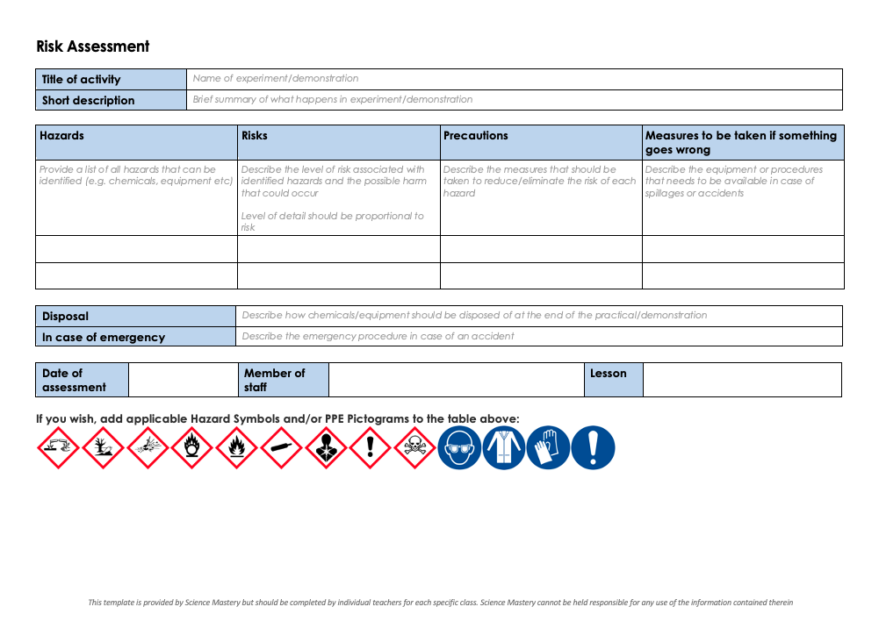
Practical Activity
This lesson contains a practical activity (either a whole class activity or a demonstration)
A risk assessment must be completed for this practical
The template risk assessment can be found here.
The risk assessment should be specific to the class involved and written only by the teaching member of staff
The risk assessment should refer to the current CLEAPSS Hazcards for all chemicals used in the practical for safety and disposal notes.
A list of chemicals used can be found in the Practical Guide
It is good practice for students to wear safety spectacles during all class practicals and demonstrations
Thank you for reading!
The Science Mastery Team

Slide 3
Making Soluble Salts
Answer the questions about the equation below.
What does the state symbol (s) tell you?
Name the reactants.
Is this symbol equation balanced? If not, balance it.
Copper sulfate (CuSO₄) is a blue colour. At the end of this reaction would you see a blue liquid or blue solid?
Name the salt produced when hydrochloric acid reacts with copper oxide.
CuO_{(s)} + H₂SO_{4(aq)} → CuSO_{4(aq)} + H₂O_{(l)}
The substance is solid
Copper oxide and sulfuric acid
Balanced, there are equal numbers of each type of atom in reactants and products
Blue liquid – (aq) means aqueous, or dissolved in water
Copper chloride
Notes:
Big idea: Reactions Rearrange Matter
Purpose: to assess learning from before the lesson and interleave prior knowledge.
Q2. Alternative spelling: sulphuric acid
Foundation: Write the general word equation for the reaction between an acid and an alkali.
Stretch: Write a balanced symbol equation for the reaction between hydrochloric acid and sodium hydroxide.
Answers:
Foundation: acid + alkali → salt + water
Stretch: HCl(aq) + NaOH(aq) → NaCl(aq) + H₂O(l)
:

Slide 4
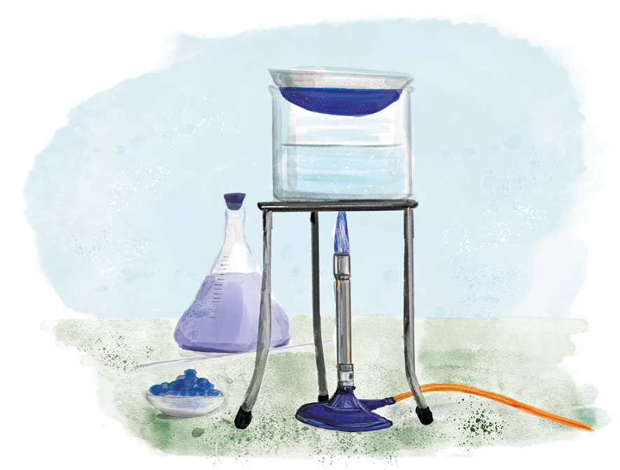

C3.2.10
17/04/2024
Making Soluble Salts
C3.2.1 Prior Knowledge Review
C3.2.2 Relative Formula Mass
C3.2.3 Percentage by Mass
C3.2.4 Conservation of Mass
C3.2.5 Balancing Equations
C3.2.6 Uncertainty
C3.2.7 Introducing Concentration
C3.2.8 Concentration Calculations
C3.2.9 Soluble Salts
C3.2.10 Making Soluble Salts
C3.2.11 Making Soluble Salts 2
Notes:
This lesson links to the big idea Reactions Rearrange Matter. In the previous lesson, students have learned the theory behind making soluble salts. In this lesson, students will learn about the steps in the method for making soluble salts, bringing together skills learned previously, such as writing a risk assessment and filtration.
Suggested hook:
Set up a simple demo of filtration (perhaps use sand and salt-water) or show students a diagram, to remind them of the setup and purpose of filtration. Ask students to explain why sand stays in the filter paper but the salt particles can pass through into the filtrate/conical flask. Salt particles are in solution and are small enough to fit through the tiny holes in the filter paper.

Slide 5

Following this lesson, students will be able to:
Prepare a pure, dry sample of crystals of a soluble salt.
Describe the key techniques required to prepare a sample of dry, soluble salt, including filtration, evaporation and crystallisation.
Explain why each step of the procedure is necessary.
Key Words:
evaporation
filtration
crystallisation
concentrated
solution

Slide 6
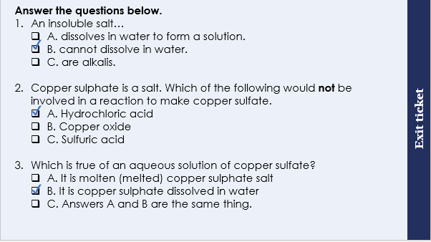
This is the fix-it portion of the lesson
The fix-it is an opportunity to respond to gaps in knowledge, especially those identified by the previous lesson’s exit ticket.
The teacher should customise this slide as needed, to facilitate
reteach, explanation, demonstration or modelling of ideas and concepts that students have not yet grasped or have misunderstood.
practise answering specific questions or of key skills.
redrafting or improving previous work.
Notes:
Purpose: to spend time on any gaps identified in previous learning from exit ticket feedback.
Fix-it guidance from previous exit ticket:
Q1. Answer: B
If students answer A, this suggests a gap in knowledge about the definitions of insoluble and soluble. To fix-it, reteach this using examples of NaCl being soluble and CuO being insoluble in water. Then ask students to explain the difference between a soluble and insoluble salt.
If students answer C, this suggests a gap in knowledge about the definition of alkalis. To fix-it, reteach that alkalis are bases that are soluble in water and a substance with a pH 8-14 that is insoluble is called a base. Then ask students to write out definitions for base and alkali.
Q2. Answer: A
If students answer B, this suggests a gap in knowledge that copper oxide produces a copper salt. If students answer C, this suggests a gap in knowledge that sulfuric acid produces a sulphate. To fix-it, model using a few example reactions, how different reactants form particular salts (e.g. copper oxide, calcium carbonate and sulfuric acid, hydrochloric acid ). Highlight/underline in different colours to show which elements in the reactants have formed the salt. Then remove and ask students to complete word equations using these same products.
Q3. Answer: B
If students answer A, this suggests a confusion between solutions and molten substances. To fix-it, ask students to write out the definition of aqueous and then ask them to explain why molten copper sulfate is not aqueous.
If students answer C, this suggests the common misconception that dissolving and melting (or a molten substance and a solution) are the same thing. To fix-it, show using particle diagrams the difference between copper sulfate solution and molten copper sulfate. Then ask students to explain the difference between a sodium chloride solution and molten sodium chloride.

Slide 7
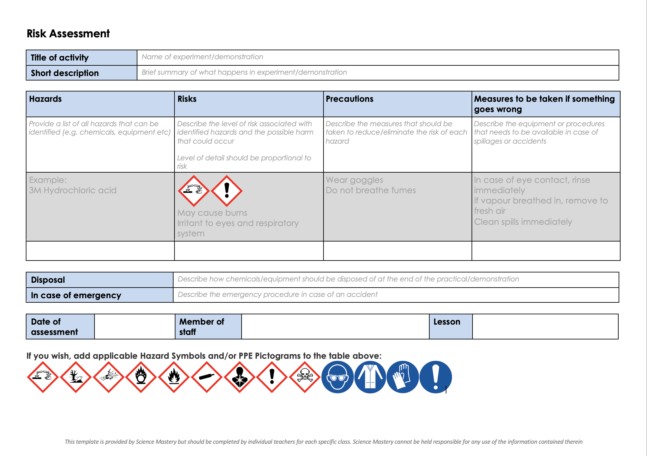
Risk Assessment
A risk assessment must be completed for this practical
The template risk assessment can be found here.

Slide 8
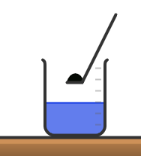
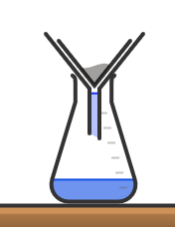
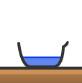
Demonstration Preparing a soluble salt
Heat the acid gently
The solid is added to the acid until no more reacts.
Excess solid is filtered off to produce a solution of the salt.
The solution is heated to evaporate the water to form a more concentrated solution.
This concentrated salt solution is crystallised to produce solid salt.
The salt is patted dry between two pieces of filter paper.
Notes:
Exposition type: Explanation
Suggested teacher exposition:
We have already learned last lesson that reacting an insoluble salt with an acid produces a soluble salt. In this practical we will get to make the soluble salt using techniques you have practiced before. Observe carefully how to do each step and always be thinking about WHY we are doing it.
Heat the acid gently - because a warmer solution will be able to react with the copper oxide faster. We will learn more about that in our next physics unit about heating.
The solid copper oxide is added to the acid until no more reacts – we call this a ‘saturated solution’ which means no more solid copper oxide could possibly react with acid.
Excess, or extra/left-over, sold is filtered using a filter paper and a funnel - this ensures that excess solid copper oxide is removed from the mixture. We wouldn’t want to find little lumps of insoluble solid in our crystals at the end!
Gently heat the filtered solution using a water bath. – why do you think we need to do this step? to evaporate some of the water to forms a more concentrated solution
The concentrated salt solution is then crystallised, which means that crystals form as the rest of the water evaporates. This can be done by leaving the crystallising dish in a warm place or by further heating.
When the salt has crystallised, we use two pieces of filter paper to gently pat the crystals dry. Then we have our final product, a sample of dry, soluble salt crystals!
Suggested guidance:
Describe the basic method as outlined on the slide then watch one of the videos of the method or alternatively ‘dry’ demo the method using the equipment (without using the chemicals). Of key importance for students to understand is the ‘why’ behind each step of this method. Ensure that this is articulated as you narrate each step of the method during this demonstration. See below for the important points to include in your narration:
There are some excellent videos on YouTube explaining how to make a soluble salt: https://www.youtube.com/watch?v=qIOMlwBoe_4 or https://www.youtube.com/watch?v=B1oS1_vDmUk are good examples.

Slide 9
Risk assessment
Apparatus/Chemical | Hazard | Precaution
Concentrated acid is corrosive and may cause chemical burns. Dilute acid is an irritant.
Hydrochloric acid
Use dilute acid.
Ensure beaker is kept away from edge of bench
Risk of burns or hair/clothing catching fire.
Do not touch apparatus until it cools down. Turn off Bunsen when not in use. Tie back hair and stand up.
Bunsen burner and hot apparatus
Cut skin from broken glass.
Hold one item at a time, with care.
Keep away from edge of bench
Glassware
Notes:
Suggested teacher exposition:
Before we do this practical, we must write a risk assessment. In previous lessons you have learned what hazards and precautions are.
What is the definition of a hazard? A hazard is something that can cause harm.
Can you name a hazard? Using corrosive substances, cuts from broken glass, risk of burning clothes or skin.
What is the definition of a precaution? A precaution is what you do to prevent a hazard from causing harm.
What precaution should you take when handling glassware? Hold one item at a time with care and keep away from the edge of the bench.
Now lets write our risk assessment for this practical because there are several hazards that we need to write precautions for.
Suggested guidance:
It’s best if this is filled out with students so that they engage with the various risks associated with this practical.
In the interest of time, for some classes it might be appropriate to print out this table for the students to fill in, instead of drawing it themselves.
It is the teacher’s responsibility to risk assess for yourself and your class. Some students will need very close supervision to ensure their safety.

Slide 10
Key techniques
Match each step of the method below with the key processes involved.
crystallisation
filtration
evaporation
neutralisation
The solid is added to the acid until no more reacts.
Excess solid is filtered off to produce a solution of the salt.
The solution is heated to evaporate the water to form a more concentrated solution.
This concentrated salt solution is crystallised to produce solid salt.
The salt is patted dry between two pieces of filter paper.
neutralisation
filtration
evaporation
crystallisation
Notes:
Suggested guidance
This could be conducted as a whole class CFU if the four processes are labelled 1/2/3/4 or A/B/C/D and students show the answer using fingers/cards/MWBs. Or this could be conducted by copying into books and then cold-call questioning the answers.

Slide 11

These step are in the INCORRECT order Discuss what the correct order should be.
Heat the solution to evaporate the water to form a more concentrated solution.
The solid is added to the acid until no more reacts.
Pat the salt dry between two pieces of filter paper.
This concentrated salt solution is crystallised to produce solid salt.
Filter the excess solid off to produce a solution of the salt.
Notes:
Answer:
B, A, E, D, C
Suggested guidance:
Talk tasks can be used in a variety of ways to suit the particular needs of the students you are teaching. Through exchanging views with others, students develop their understanding of the science beyond what could be achieved individually.
Science classrooms that successfully integrate talk have the following features:
Science talk is a regular feature of lessons and is woven into classroom activities.
Students are paired or grouped strategically by the teacher to ensure productive interaction. This might take into consideration the students’ proficiency of the English language, how encouraging they might be to peers and their attainment in the topic. It’s a good idea to consider these pairings in the class seating plan.
Students are encouraged and supported to talk, but are not forced to talk.
The teacher should take on the role of a facilitator, engaging with conversations where necessary and encouraging or steering the conversation where needed.
Students are encouraged to use the language they have to express their ideas (e.g., everyday language, imperfect English, native language), but also to incorporate science specific terminology where this is more accurate or has been taught.
6. Scientifically inaccurate ideas are not dismissed by the partner or teacher; open discussion and further investigation are relied on to help students construct ideas that support them to progress in their scientific understanding.
7. Guidelines for behaviour during talk tasks are explicit and frequently reviewed. Rules for students might be:
Listen carefully to your partner
Take turns talking.
Speak one at a time, without interrupting.
Politely agree or disagree and explain why.
Politely point out if your partner has used a scientific word incorrectly, if they have explained the science incorrectly, or if there is a more accurate way to describe something.
If confused, ask questions.
Stay focused on the discussion topic.
Respond to one another.

Slide 12
Practical activity: Preparation of a pure dry sample of a soluble salt from an insoluble oxide
Follow the practical method to prepare a pure dry sample of a salt. Once you have finished, answer the questions below.
Name the chemical processes and techniques involved in the preparation.
Name the two reactants required to make the salt.
Write a word equation for the reaction.
Write a balanced symbol equation for the reaction.
Neutralisation, filtration, evaporation, crystallisation
Sulfuric acid and copper oxide.
Sulfuric acid + copper oxide → copper sulfate + water
H₂SO₄ + CuO → CuSO₄ + H₂O
Notes:
Suggested guidance:
There is a worksheet in the folder with some questions and the full method for students to refer to during the practical.
Please note: the answers to questions 2 - 4 will differ depending on which chemicals you are using.
Questions you could ask the students during the practical:
What safety precautions should you take when carrying out this experiment and why?
Why was it necessary to warm the sulfuric acid?
What colour was the copper sulfate solution that formed?
Why was it necessary to add copper oxide until it was present in excess?
How did you know when the copper oxide was present in excess?
How did you separate the excess copper oxide from the copper sulfate solution?
What is meant by the filtrate?
What is meant by the residue?
What is the filtrate in this experiment?
What is the residue in this experiment?
Why is a water bath used to evaporate the water from the copper sulphate solution instead of heating the evaporating basin directly with a Bunsen burner?
Why should you not evaporate all of the water from the copper sulphate solution?
From: http://qualifications.pearson.com/content/dam/pdf/GCSE/Science/2016/teaching-and-learning-materials/GCSE-9-1-Sciences-core-practical-guide.pdf

Slide 13
Drill
Acid is added to a metal oxide. What is the name of this reaction?
How are crystals made from this reaction? Whilst preparing a soluble salt excess solid metal oxide is added. Why is this?
You have a mixture of insoluble copper oxide and dissolved copper sulfate. How will you separate them? A soluble salt is heated, and it becomes a more concentrated solution. What is the name of this process?
What is the hazard for an acid?
What precaution must you take for an acid?
What precaution must you take for hot apparatus and Bunsen burners?
Notes:
Purpose: This is a knowledge drill. The purpose of this is to check that the critical knowledge is secure before pupils move onto independent practice.
Suggested guidance: There are a range of ways this could be done depending on time and ability range of the class:
Mini whiteboards
As full sentences in exercise books
As short answers in exercise books
In the pupil workbook
As pair talk
As cold call

Slide 14
Drill answers
A neutralisation reaction
Heating a soluble salt until all the water has evaporated
To ensure that all the acid has reacted excess metal oxide is added
Copper oxide can be separated from solution using filtration
Evaporation is the process where a less concentrated solution becomes more concentrated
Hazard for an acid: If it is concentrated, then its corrosive, if it is dilute, then it can be irritating
The precaution for an acid is to use a more dilute acid where possible. Ensure containers are kept away from edge of bench
Precautions for hot substances and Bunsen burner: Do not touch apparatus until it cools down. Turn off Bunsen when not in use. Tie back hair and stand up
Notes:
Purpose: This is a knowledge drill. The purpose of this is to check that the critical knowledge is secure before pupils move onto independent practice.
Suggested guidance: There are a range of ways this could be done depending on time and ability range of the class:
Mini whiteboards
As full sentences in exercise books
As short answers in exercise books
In the pupil workbook
As pair talk
As cold call

Slide 15
I: Preparing a soluble salt
Heat the acid gently
The solid is added to the acid until no more reacts.
Excess solid is filtered off to produce a solution of the salt.
The solution is heated to evaporate the water to form a more concentrated solution.
This concentrated salt solution is crystallised to produce solid salt.
The salt is patted dry between two pieces of filter paper.
Notes:
This was carried out as the demo, but you may want to remind students of the key steps involved

Slide 16
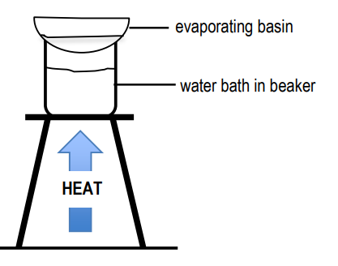
We: Preparing a soluble salt
Describe how to prepare pure dry crystals of copper sulfate.
Describe what is happening in each stage.
Set up a water bath and place the evaporating basin containing copper sulfate solution. Warm this gently until most of the water has evaporated
Add a spatula full of copper oxide to warmed sulfuric acid. Once reacted add more until copper oxide is in excess
Separate the insoluble copper oxide from the copper sulfate solution
Notes:
This slide models the process of answering a describe question.
Firstly, students are presented with a generic describe question, along with a model answer. Students are also given some simple guidance to follow for producing their own describe answer.
The generic question and answer should be used by the teacher to remind students of
the key features of a great answer
how to structure their answer
why the model answer is a good example
Following this, students will be required to apply this process to answer their own describe question, which will appear in place of the generic questions. This describe question will be specific to the topic students are learning about in the lesson. Give students time to write their own answer to this, ensuring that they use the guidance provided. To further scaffold this task for students, it may be appropriate to:
pair students up to write an answer together
list for students the key words you would like them to include in the answer
provide a writing frame or ‘points to include’ for students
A model answer for this question will appear. Teachers should review the model answer with students by referencing the guidance in the green box. For example ‘we can see item 1 in the guidance is to use bullet points to keep your answer clear. Notice in the model answer here we have done just that’. Or ‘item 2 in the guidance here says that we should use scientific keywords in the answer. Has this been achieved in the model answer? Where can we see this?’.

Slide 17
You: Preparing a soluble salt
Describe how to prepare pure dry crystals of magnesium sulfate.
Model answer:
Measure out about 25 cm³ of sulfuric acid using a measuring cylinder and place it in a 100 cm³ beaker.
Gently warm the mixture using a Bunsen burner. Do not boil the acid.
Add a spatula magnesium oxide and stir. After a short time, the base will all react producing a colourless solution.
Keep adding Magnesium oxide one spatula at a time until it no longer reacts.
Filter and wash the mixture into a conical flask.
While the mixture is filtering, set up a water bath using a half full 250 cm³ beaker of water on a gauze above a Bunsen. Start heating the water.
Once the filtration is complete, transfer some of the filtrate to an evaporating basin (do not more than half fill the basin).
Carefully place the basin on the water bath and heat to allow some of the water to evaporate from the magnesium sulfate solution. If time allows, keep heating until crystals start to appear and then stop heating.
Notes:
This slide models the process of answering a describe question.
Firstly, students are presented with a generic describe question, along with a model answer. Students are also given some simple guidance to follow for producing their own describe answer.
The generic question and answer should be used by the teacher to remind students of
the key features of a great answer
how to structure their answer
why the model answer is a good example
Following this, students will be required to apply this process to answer their own describe question, which will appear in place of the generic questions. This describe question will be specific to the topic students are learning about in the lesson. Give students time to write their own answer to this, ensuring that they use the guidance provided. To further scaffold this task for students, it may be appropriate to:
pair students up to write an answer together
list for students the key words you would like them to include in the answer
provide a writing frame or ‘points to include’ for students
A model answer for this question will appear. Teachers should review the model answer with students by referencing the guidance in the green box. For example ‘we can see item 1 in the guidance is to use bullet points to keep your answer clear. Notice in the model answer here we have done just that’. Or ‘item 2 in the guidance here says that we should use scientific keywords in the answer. Has this been achieved in the model answer? Where can we see this?’.

Slide 18
1. Draw a flow diagram to show each step of the method for this experiment.
Keep it simple! Use diagrams of the and only one sentence for each step.
Write two key words next to each step, one should be the name of a piece of equipment, the other a scientific process or technique e.g. filter paper, filtration.
2. Compare your method to the practical method – did you miss anything out?
Step 1
Step 2
Step 3
Notes:
Purpose: to check that key knowledge from the introduce phase has been learnt and understood.
This activity helps students to summarise the practical in images and as few words as possible. If you have time, discuss each step and its purpose.
There is a Quizlet available on the topic: https://quizlet.com/gb/268806965/unit-4-chemical-changes-practical-preparation-of-a-pure-dry-sample-of-a-soluble-salt-from-an-insoluble-oxide-or-carbonate-flash-cards/

Slide 19
Answer the questions below.
Which of the following is a precaution when preparing a soluble salt?
A. Concentrated acid is corrosive.
B. Allow hot glassware to cool before touching it.
C. Concentrated acid can cause chemical burns.
After which process/technique are you left with a copper oxide residue?
A. crystallisation
B. evaporation
C. filtration
Once the copper sulfate solution is prepared, why do we evaporate off some water using the Bunsen burner?
A. to make the solution stronger
B. to make the reaction happen faster
C. to make the solution more concentrated
✓
✓
✓
Notes:
Q1. Answer: B
If students answer A or C, this suggests a confusion between hazards and risks. To fix-it, recap the definitions of hazards and precautions and then ask students to sort the following into hazard and the linked precaution: broken glassware can cut, Bunsen flame can burn hair or skin, hot glassware can burn skin, irritants can irritate skin, be careful handling glass and keep it centre of the table, tie back hair and stand up and away from Bunsen flame, let glassware cool down before touching, ensure containers are kept away from the edge of the bench and be ready to wash skin under running water if in contact with irritants.
Q2. Answer: C
If students answer A, this suggests a misconception that crystallisation ends up making a residue. To fix-it, reteach that crystallisation makes crystals. Then ask students to describe what happens during crystallisation and during filtration.
If students answer B, this suggests a misconception that evaporation ends up making a residue. To fix-it, reteach that evaporation means water has left the solution, leaving behind the solute/soluble salt. Then ask students to describe what happens during evaporation and during filtration.
Q3. Answer: C
If students answer A, that students have confused the terms ‘strong’ and ‘concentrated’. This distinction was made initially when students studied acids and alkalis in C2.1 and should be revised here. To fix-it, show students examples of strong and weak acids with reference to the pH scale. Then contrast this with a concentrated and dilute solution, using particle diagrams to illustrate what these terms mean.
If students answer B, this suggests a confusion of this step with the one where the Bunsen heats the acid in order to speed up the (rate of) reaction.
To fix-it, ask the students order the steps of the method when you present it to them in a random order. Then ask students to explain why each step is important.

Slide 20
Lesson C3.2.10
What was good about this lesson? | What can we do to improve this lesson?
Send us your feedback by clicking this link
or by emailing sciencemastery@arkonline.org
Thank you!

